Slide 1
2022
上海迪赫自动化有限公司
Shanghai DIHE Automation Co., Ltd
公司介绍
Profile Presentation

Slide 2
Company Profile
DIHE is a professional high-tech manufacturer, dedicated to providing retrofit, retooling, relocating and maintenance service of metal-cutting production line to realize customized production for specific product, such us cylinder head, cylinder block, transmission case, and other related engine parts.
We are capable to deliver production line with turnkey solutions, including
machining process design
fixture design and manufacturing
cutting tool deisng and application
machining center cutting programming
commissioning to reach cutting capability and cycle time
DIHE office in Shanghai and plant in Xiangyang.

Slide 3
Company Profile
DIHE established good cooperative relationship with a lot of auto and auto-related manufaturers in China, inclduing Dongfeng Dingxin, Dongfeng Auto Wuhan, Dongfeng Equipment, JMC, Chery Auto, Dofeng Peugeot & Citroen, COMAU Shanghai, MAPAL Shanghai, etc.
Since DIHE’s foundadtion in 2018, the company keeps living up to the belief of :
honest selling, best quality, people-orientation and benifits to cusotmers.
We are doing everyting to offer our customers with best services and best products. We promise that we’ll be responsible all the way to the end once our services begin.

Slide 4
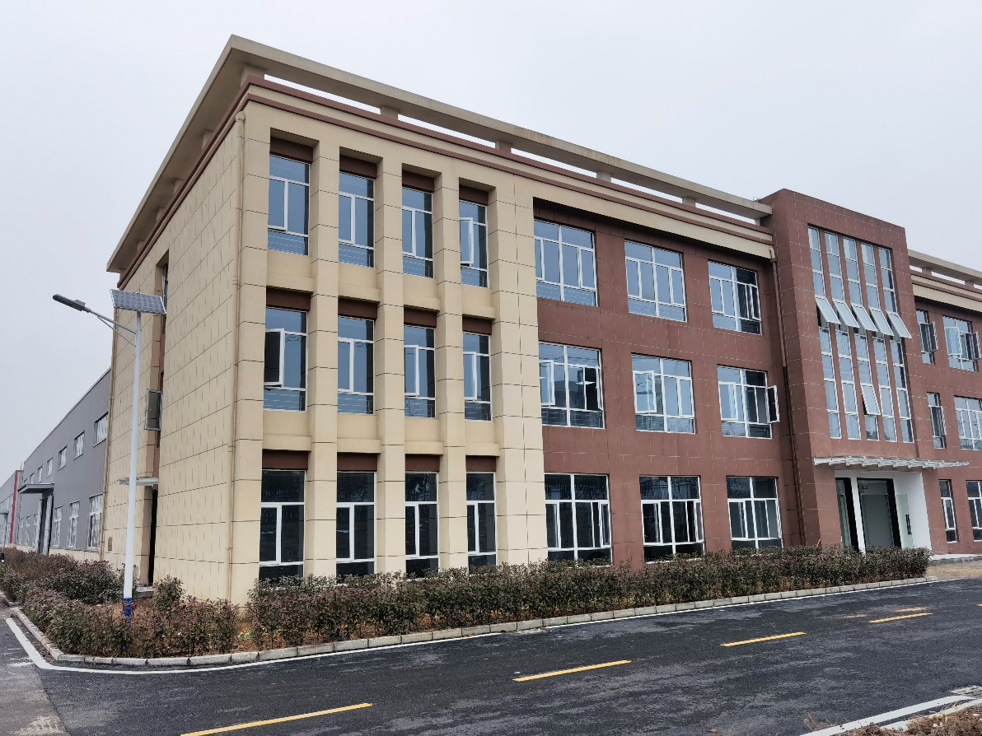
Scope of bussiness
Turnkey solutions for retrofit, upgrading and retooling on metal-cutting productoin lines of cylinder block, cylinder head, transmission case, NEV reducer case, etc.
Machining center spinlde maintenance.
OEM of NEV reducer case and moter case.

Slide 5
Telant on team
-3 mechanical design engineers, 16 year experience in machining precess design and fixture desgin.
-6 Automation control senior engineers, 18 year experience in automation control design and commissioning, proficient in gantry, Fanuc/ABB/KUKA robot, and various system of PLC programming and commissioning.
-12 machining center commissioning senior engineers, 10 year experience in global famous machining center commissioning, proficient in machining process of cylinder block & head, NEV transmission case and moter case.
-16 equipment mechanical egineers, 20 year experience in equipment maintenance, proficient in varous machining center retrofit and retooling.
-3 project managers, 10 year experience in project management of global machining center company, PMP holders.

Slide 6
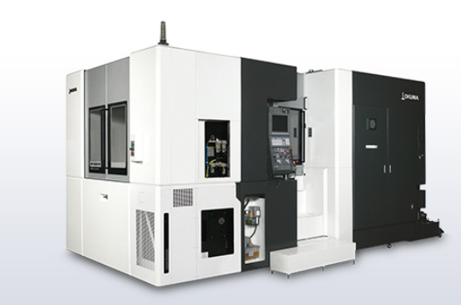
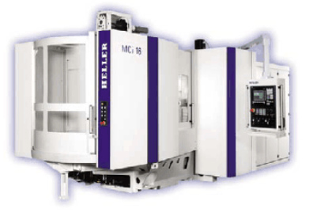
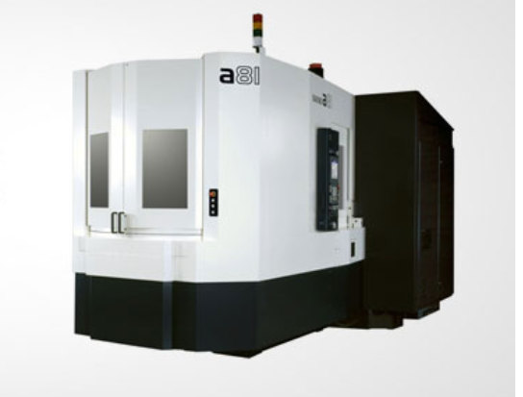
Project Experience
Chery Auto:E4G16 cylinder head line and cyliner block line
Retooling to increase production volume to 600k
Makino A71\A81、 HELLER MCI 16.1、Okuma MA-500 HA
CNC Qty：Makino 19 pcs，HELLER 16 pcs，Okuma 14 pcs
◈ Project scope:
CNC, fixture precision validation
CNC machining programing and commissioning to reach capablity and cycle time.
Training on machining program and CNC maintenance.

Slide 7
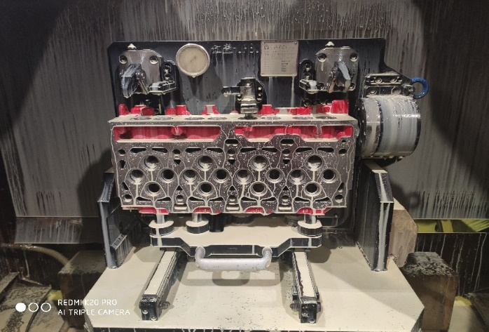
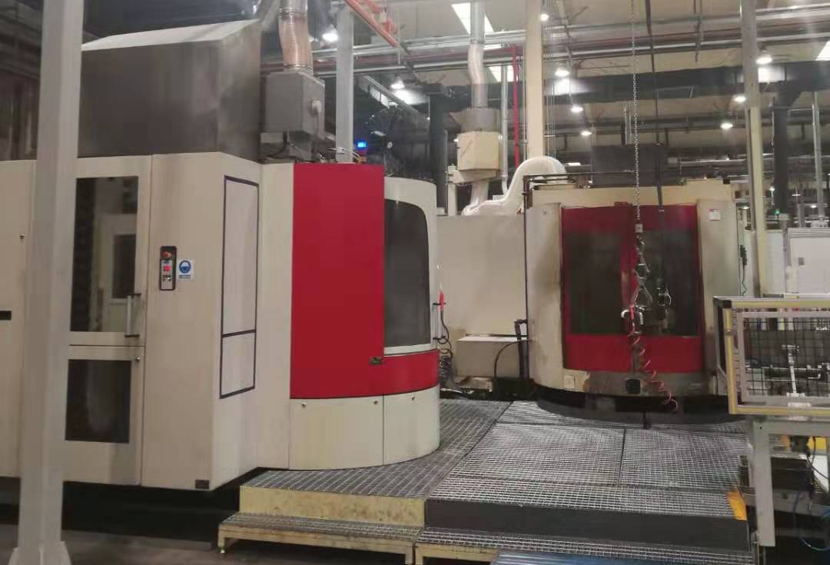
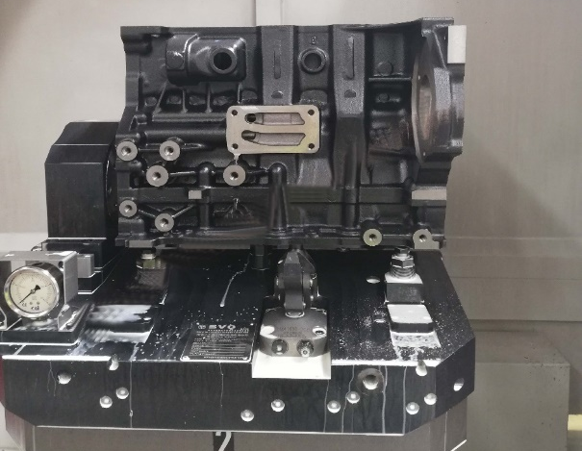
Project Experience
JAC Cummins diesel cylinder block & head line relocating and retooling.
CNC: Heckkert HEC 400D 、CWK 500
CNC Qty: 3 pcs
◈ Project scope:
Production line relocating to new plant.
Retrofit to change guide and ball screw.
CNC precision validation.
CNC machining programing and commissioning to reach capablity and cycle time.

Slide 8
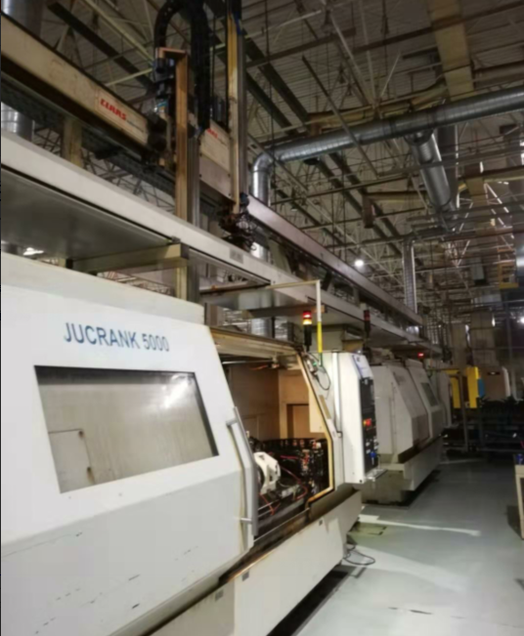
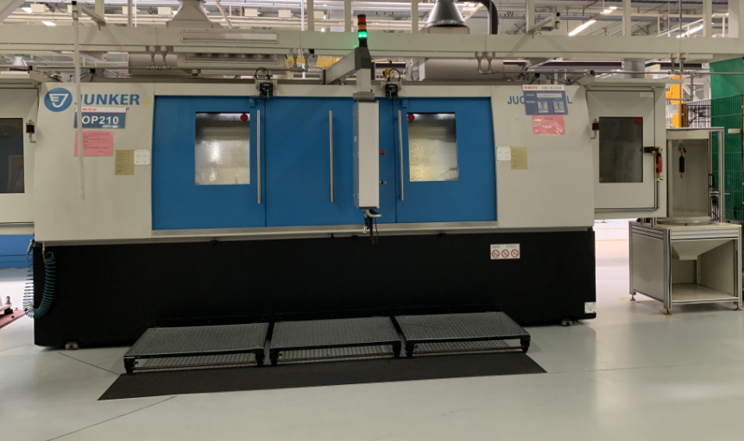
Project Experience
Chery Atuo:crankshaft line relocating.
Machine: Junker JUCRANK 5000
Gantry：GUDEL
◈ Project scope:
CNC and gantry relocating and precision validation.
Commissioning for production recovery.

Slide 9
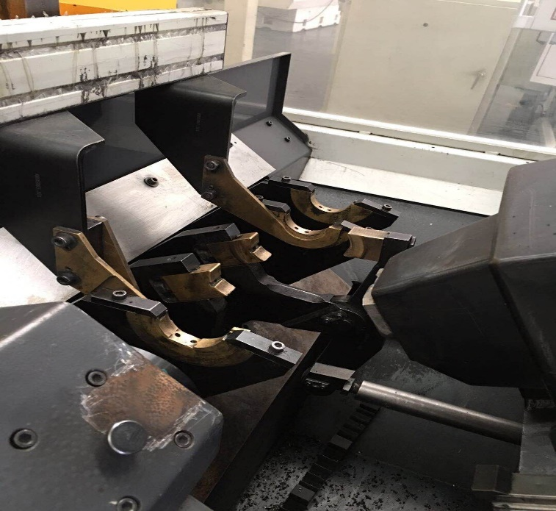
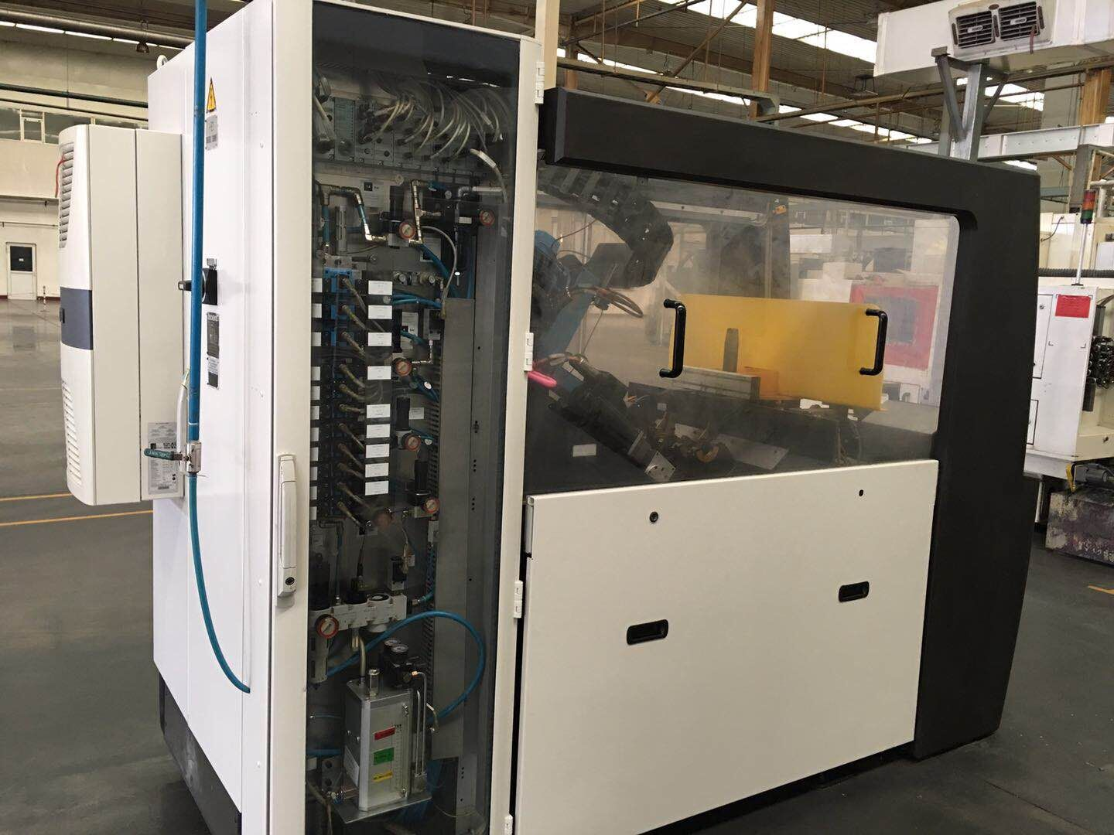
Project Experience
Great Wall crankshaft line relocating.
Machine: Schenck balancing
Gantry：GUDEL
◈ Project scope:
Machine and gantry relocating and precision validation.
Commissioning for production recovery.

Slide 10
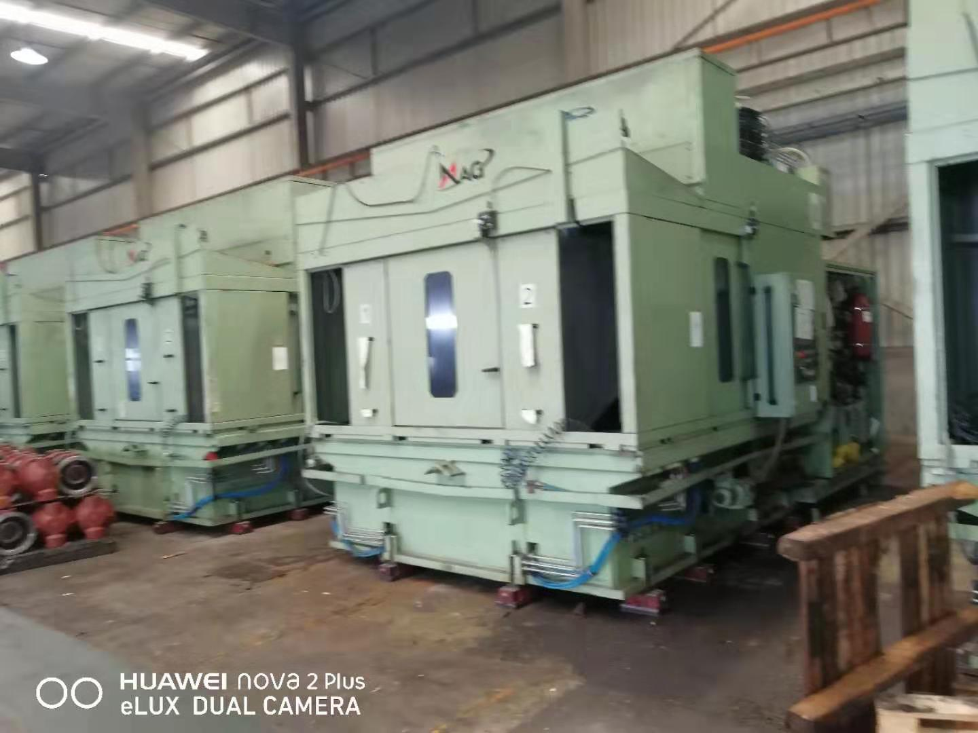
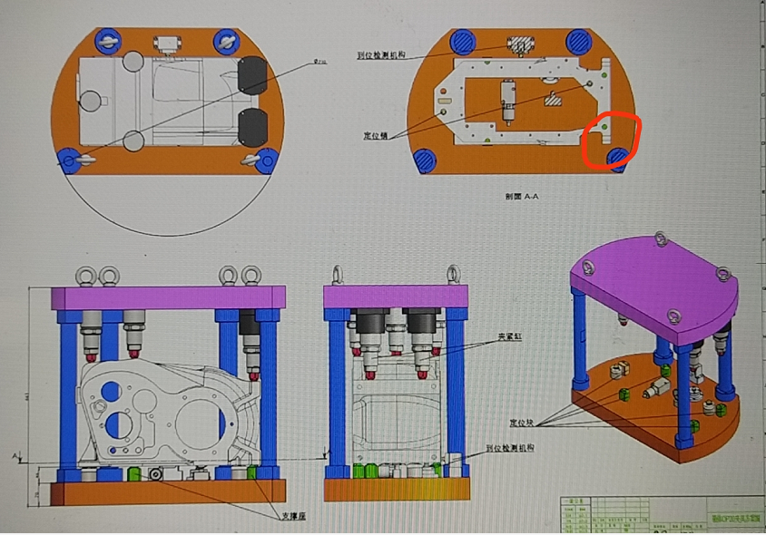
Project Experience
JMC transmission case line retooling
Machine: MAG twin-spindle
Machine Qty：2 pcs
◈ Project scope:
Machine precision validation.
Retooling: cutting tool, fixture and maching program
Machine capability and cycle time.

Slide 11
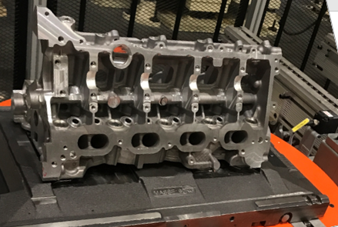
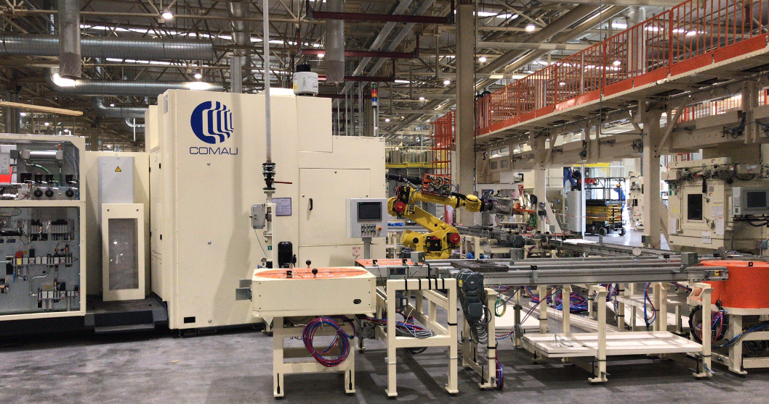
Project Experience
Dongfeng Auto HR13 cylinder head line retooling
CNC: COMAU URANE V3.8 、SD700L
Gantry：COMAU
CNC Qty: 13 pcs
◈ Project scope:
retooling for new product: cutting tool, fixture and machining program.
Machine capability and cycle time.

Slide 12
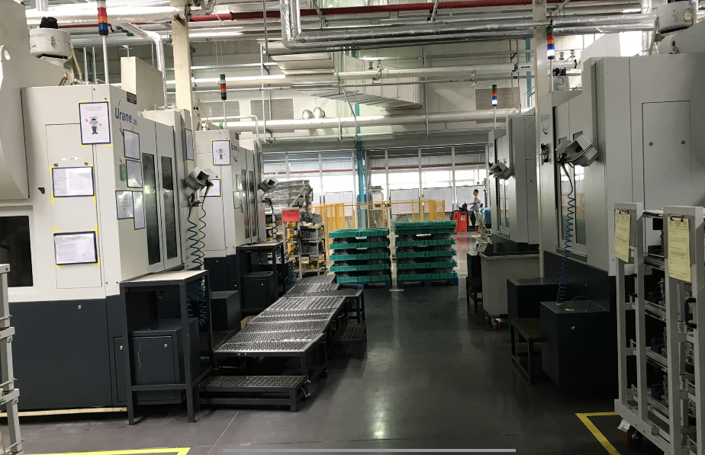
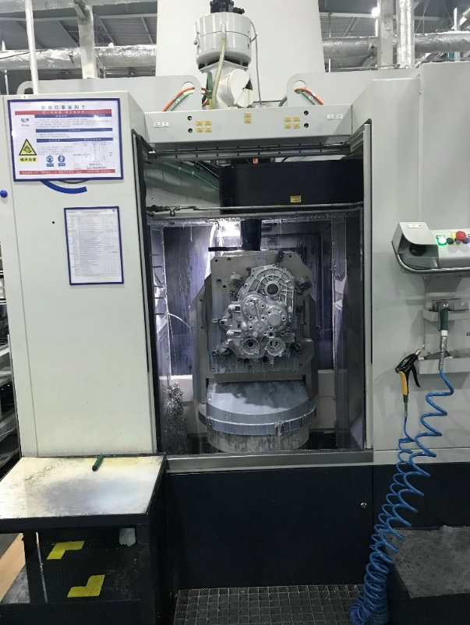
Project Experience
Dongfeng Dingxin NEV transmission case line retooling
CNC: COMAU URANE V3.4
Gantry：COMAU
CNC Qty: 4 pcs
◈ Project scope:
retooling for new product: cutting tool, fixture and machining program.
commissioning, 80% tolerance.

Slide 13
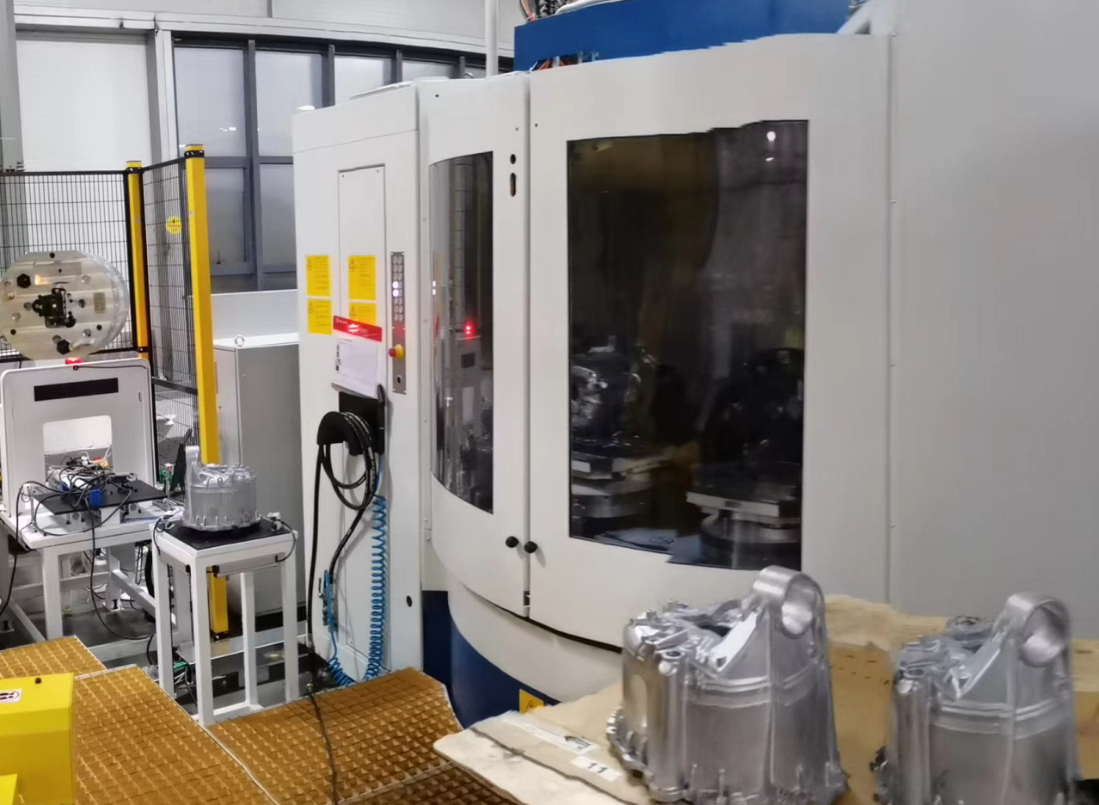
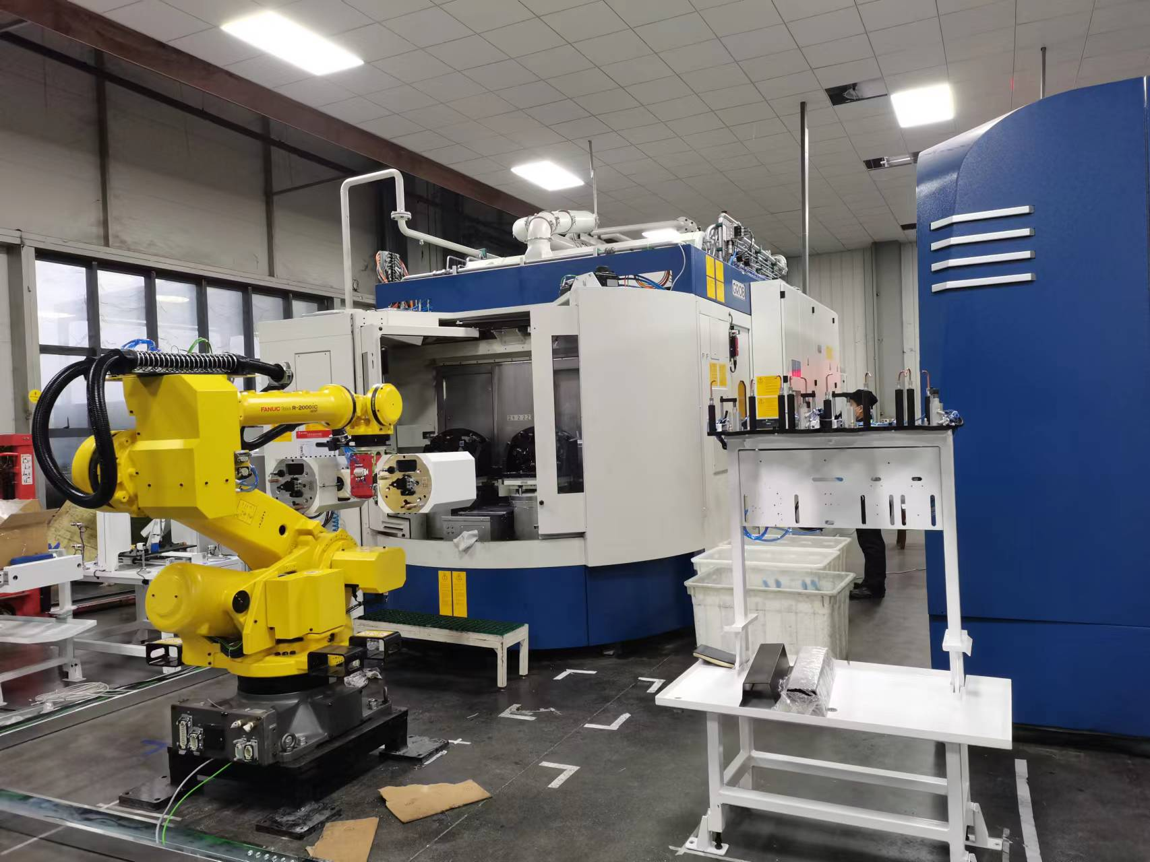
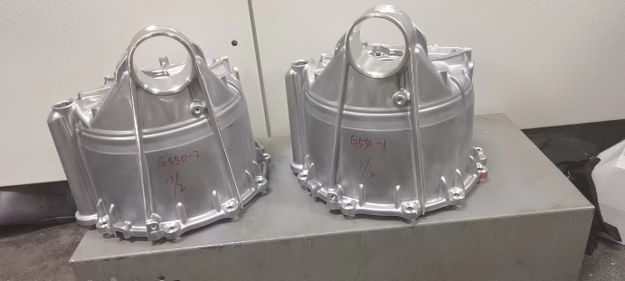
Project Experience
Chngqing Millison Tesla moter case line retooling
CNC: GROB G500\G550\G320
CNC Qty: 10 pcs
◈ Project scope:
machining programming for new product.
machine capability and cycle time.

Slide 14
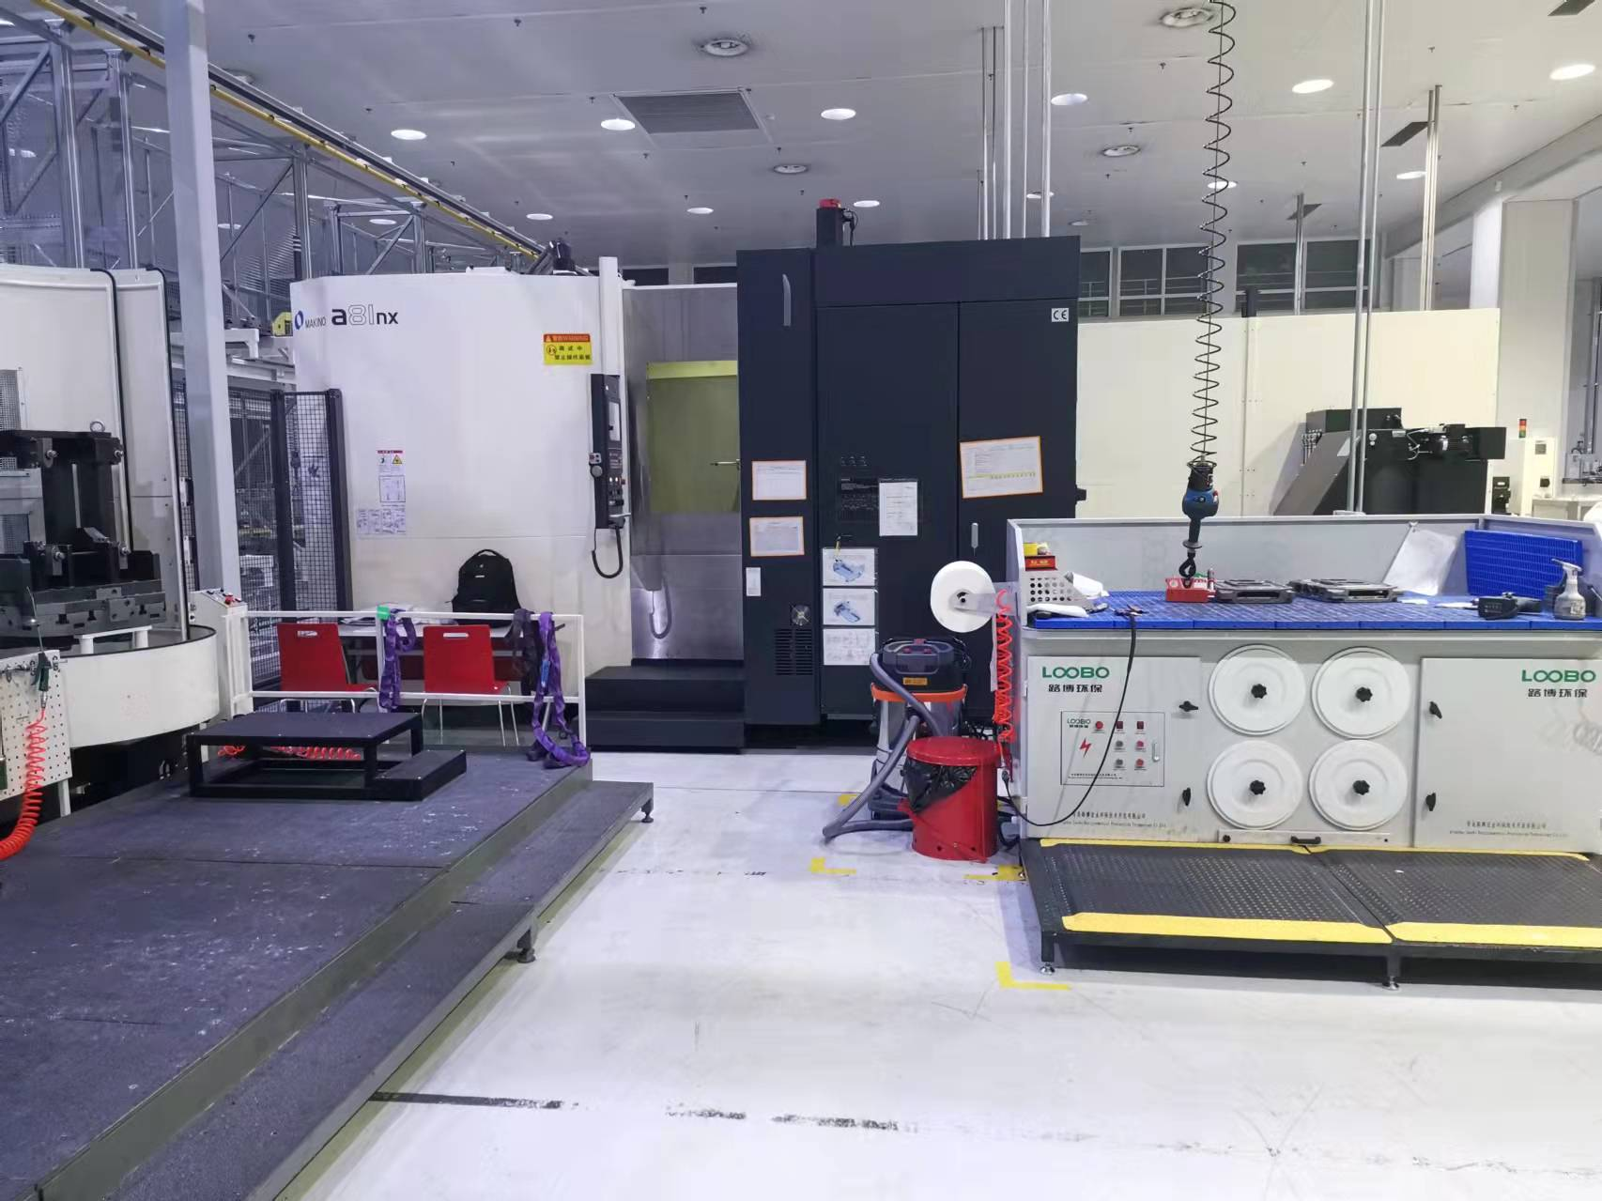
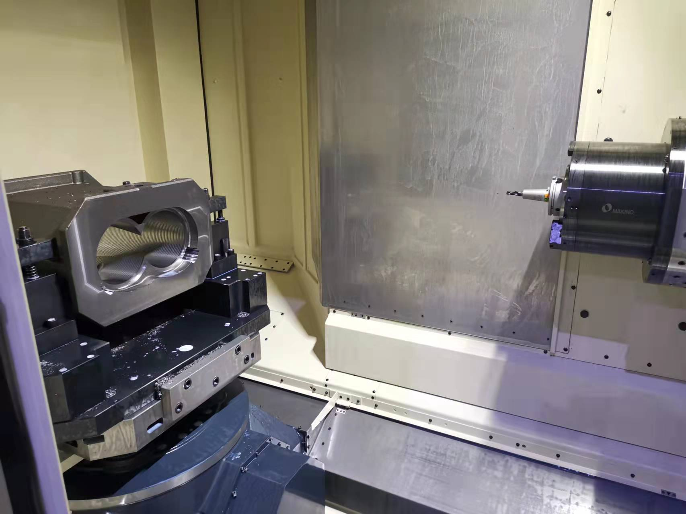
Project Experience
Qingdao Edwards: vacuum pump case line retooling
CNC: Makino A81
CNC Qty：5 pcs
◈ Project scope:
machining programming for new product.
machine capability and cycle time.

Slide 15
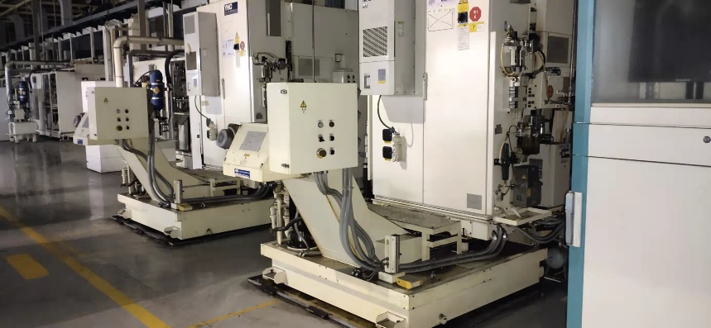
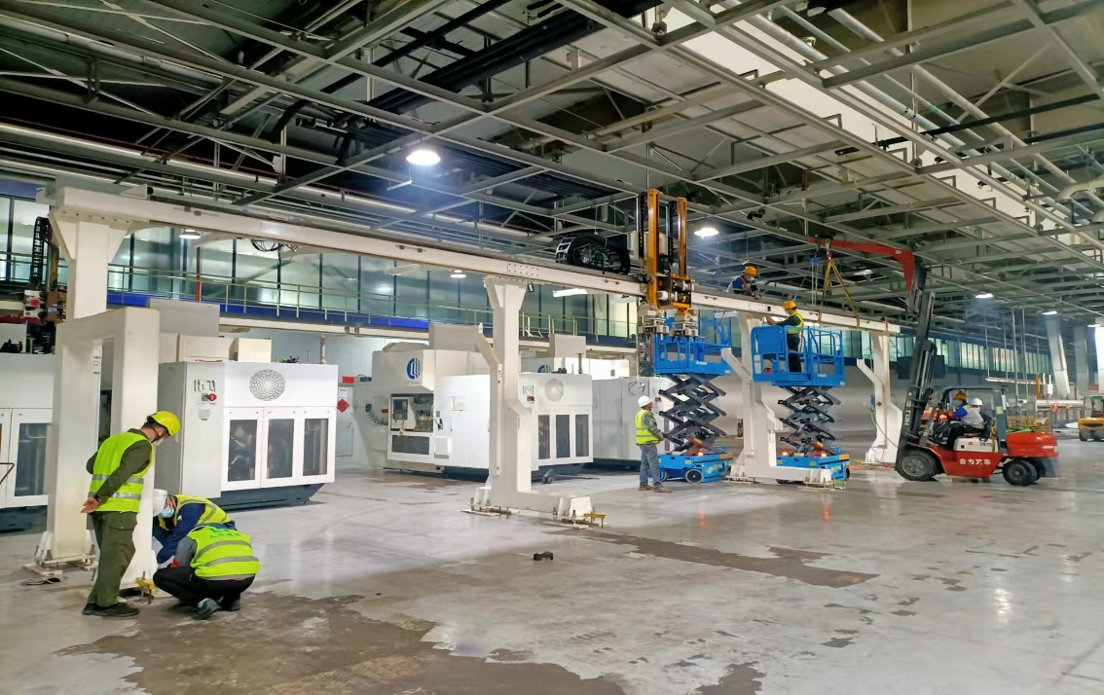
Project Experience
Chang’an Auto: NE1 cylinder head line retooling
CNC: YNC
Gantry: MRT、GUDEL
CNC Qty: 25 CNC, 10 GUDEL, 4 MRT
◈ Project scope:
machining programming for new product.
machine capability and cycle time.

Slide 16
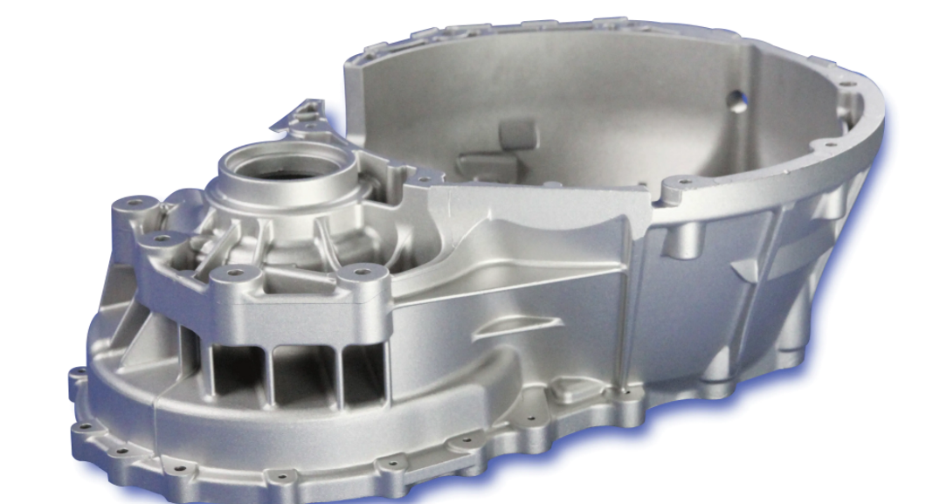
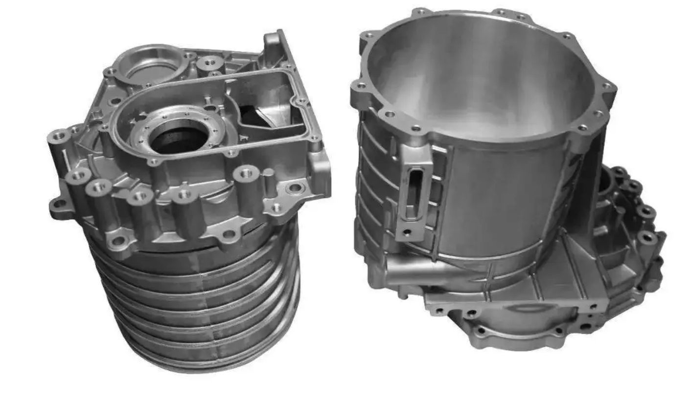
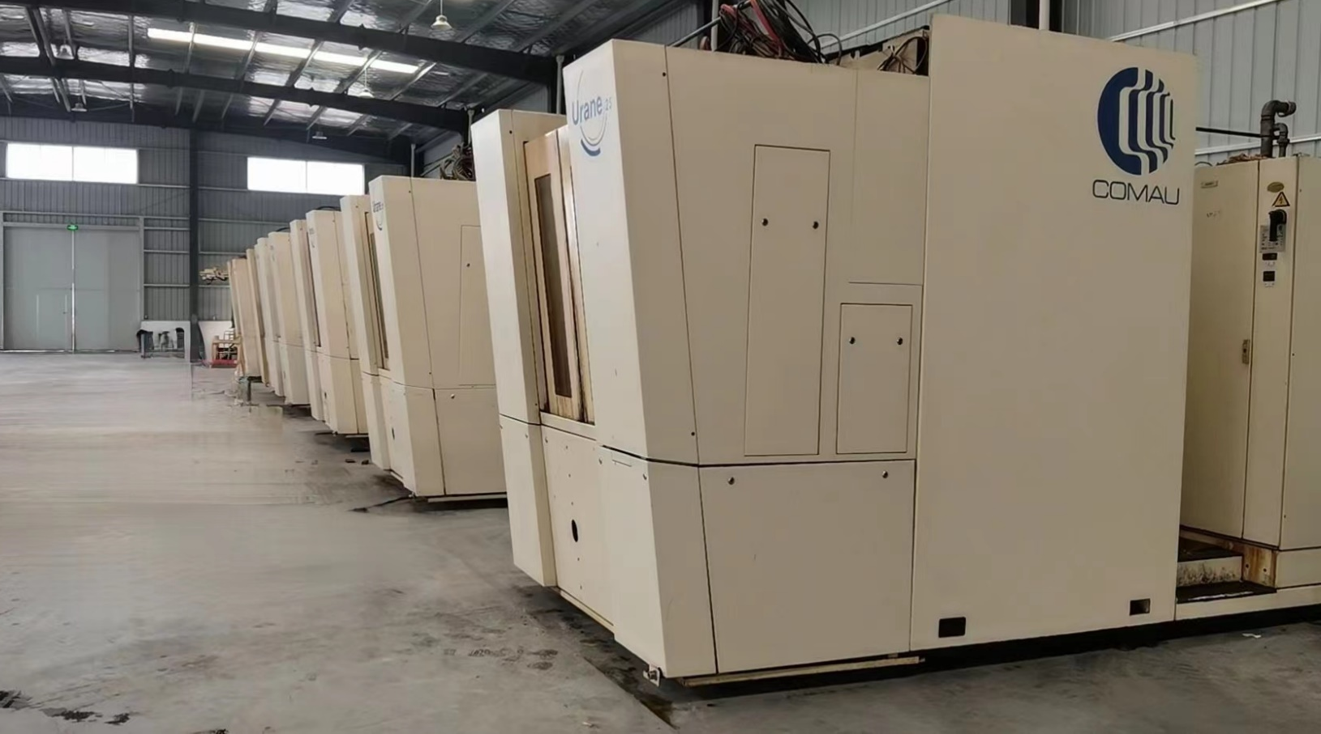
OEM
COMAU 5 axis CNC in Xiangyang plant
OEM product
Part material: Aluminum
Hign precision

Slide 17
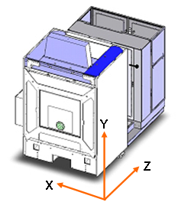
OEM
 | Urane 25 V3.4
Range of Motion运动范围
X Axis X轴 | 800 mm
Y Axis Y轴 | 700 mm
Z Axis Z轴 | 400 mm
Dynamic Performance动态性能
Rapid Traverse X – Y – Z axes 快速移动 X – Y – Z 轴 | 80 m / min
Positional Accuracy X – Y – Z axes 定位精度 X – Y – Z 轴 | 0.004 mm (to ISO 230-2_1997) * 0.004 mm (按 ISO 230-2_1997) *
Repeatability X – Y – Z axes 重复精度 X – Y – Z 轴 | 0.003 mm (to ISO 230-2_1997) 0.003 mm (按 ISO 230-2_1997)
Acceleration X – Y axes 加速度 X – Y 轴 | 10 m/s²
Z axis Z 轴 | 15 m/s²
主轴转速 | 24000 r/min
主轴功率 | 25KW
主轴内冷压力 |  | 70Bar
Electrical supply: 3 Phase AC + Distributed neutral 电源：3相交流电+中性线 | 380 to 480 V 380到480V
No cos Ø power factor correction 无功率补偿因子 cos Ø | 50 to 60 Hz 50到60Hz
Hydraulic System液压系统压力 |  | 80Bar

Slide 18
Thank you!

